Slide 1
Chapter 22: Management and Governance

Slide 2
Chapter Outline
Planning
Organizing
Implementing
Measuring
Governance
Summary

Slide 3
Planning
The planning for a project proceeds over time.
There is an initial plan that is necessarily top-down to convince upper management to build this system and give them some idea of the cost and schedule.
This top-down schedule is inherently going to be incorrect, possibly by large amounts.
Once the system has been given a go-ahead and a budget, the architecture team is formed and produces an initial architecture design.

Slide 4
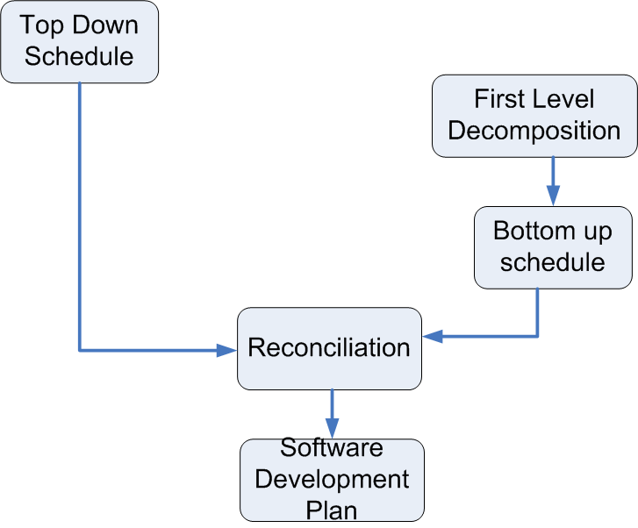
The Planning Process

Slide 5
Top Down Schedule
A top down schedule is needed to enable management to decide whether to do the project and to allocate resources.
Example: For a medium size project (~150K SLOC)
Number of components to be estimated: ~150
Paper design time per component: ~4 hours
Time between engineering releases: ~8 weeks
Overall project development allocation:
40 percent design: 5 percent architectural, 35 percent detailed
20 percent coding
40 percent testing

Slide 6
Remaining Planning Steps
An architecture team is created and they develop the first level decomposition of the architecture.
Each member of the architecture team will be the lead architect for each major subsystem.
A bottom up schedule is created by the architecture team
Typically more accurate than the top down schedule
The top down and the bottom up schedules must be reconciled to produce final (initial) schedule.
Software development plan is written that specifies releases dates and features per release. This plan guides the initial activities of the project.

Slide 7
Organizing
Division of responsibilities between project manager and software architect
Global Software Development

Slide 8
Project Manager and Software Architect
This is the most important working relationship on the team.
The people in each role—PM and SA—must
Respect each other
Coordinate
Stick to their respective spheres.

Slide 9
Project Management Body of Knowledge (PMBOK)
Published by the Project Management Institute
ANSI and IEEE standard
Nine project management areas
Integration Management
Scope Management
Time Management
Cost Management
Quality Management
Human Resource Management
Communications Management
Risk Management
Procurement Management

Slide 10
Integration Management
Ensuring that the various elements of the project are properly coordinated.
Developing, overseeing, and updating the project plan. Managing change control process.
PM: Organizes project, manages resources, budgets and schedules. Defines metrics and metric collection strategy. Oversees change control process.
SA: Creates design and organizes team around design. Manages dependencies. Implements the capture of the metrics. Orchestrates requests for changes. Ensures that appropriate IT infrastructure exists.

Slide 11
Scope Management
Ensuring that the project includes all of the work required and only the work required.
Requirements
PM: Negotiates project scope with marketing and software architect.
SA: Elicits, negotiates, and reviews run time requirements and generate development requirements. Estimates cost, schedule, and risk of meeting requirements.

Slide 12
Time Management
Ensuring that the project completes in a timely fashion.
Work breakdown structure and completion tracking. Project network diagram with dates.
PM: Oversees progress against schedule. Helps define work breakdown structure. Schedule coarse activities to meet deadlines.
SA: Helps define work breakdown structure. Defines tracking measures. Recommends assignment of resources to software development teams.

Slide 13
Cost Management
Ensuring that the project is completed within the required budget.
Resource planning, cost estimation, cost budgeting.
PM: Calculates cost to completion at various stages, makes decisions regarding build/buy and allocation of resources.
SA: Gathers costs from individual teams, makes recommendations regarding build/buy and resource allocations.

Slide 14
Quality Management
Ensuring that the project will satisfy the needs for which it was undertaken.
Quality & Metrics
PM: Defines productivity, size, and project-level quality measures.
SA: Designs for quality and tracks system against design. Defines code-level quality metrics.

Slide 15
Human Resource Management
Ensuring that the project makes the most effective use of the people involved with the project.
Managing people and their careers
PM: Maps skill sets of people against required skill sets. Ensures that appropriate training is provided. Monitors and mentors career paths of individuals. Authorizes recruitment.
SA: Defines required technical skill sets. Mentors developers about career paths. Recommends training. Interviews candidates.

Slide 16
Communications Management
Ensuring timely and appropriate generation, collection, dissemination, storage, and disposition of project information.
Communicating
PM: Manages communication between team and external entities. Reports to upper management.
SA: Ensures communication and coordination among developers. Solicits feedback as to progress, problems, and risks.

Slide 17
Risk Management
Identify, analyze and respond to project risk.
Risk Management
PM: Prioritizes risks, reports risks to management, takes steps to mitigate risks.
SA: Identifies and quantifies risks, adjusts architecture and processes to mitigate risk.

Slide 18
Procurement Management
Acquire goods and services from outside organization.
Technology
PM: Procures necessary resources. Introduces new technology.
SA: Determines technology requirements. Recommends technology, training, and tools.

Slide 19
Global Software Development
A very common development context.
Driven by
(Labor) costs
Skill sets and labor availability.
Local knowledge of markets.
Global development means that coordination among teams is critical.

Slide 20
Team Coordination Induced by Module Interaction
Team A
Team B
Coordination
Module A
Module B
Dependency
If there is a dependency between two modules, the teams assigned to those modules must coordinate over the shared interfaces.

Slide 21
Coordination
Local coordination can be informal and spontaneous.
Remote coordination must be more structured.
Coordination mechanisms:
Documentation
Meetings
Electronic media

Slide 22
Implementation Issues
Trade-offs
Incremental development
Tracking progress

Slide 23
Trade-offs
Software architect makes trade-offs among various quality attributes.
Project manager makes trade-offs among
Features
Schedule
Quality
Project manager should resist creeping functionality (scope creep)
Affects schedule
Can use a Change Control Board to manage (typically slow down) the pace of changes

Slide 24
Incremental Development
A release may be in one of three states
Planning
Development
Test and repair
All three states can be simultaneously active for different releases.

Slide 25
Tracking Progress
Progress can be tracked through
Personal contact (doesn’t scale)
Meetings
Metrics
Risk management
Meetings
Expensive use of time
Either status or working – do not intermix
One output of status meetings should be risks
Risks have
Cost if they occur
Likelihood of their occurrence
Project manager prioritizes risks

Slide 26
Measuring
Metrics are an important tool for project managers. They enable the manager to have an objective basis both for their own decision making and for reporting to upper management on the progress of the project.
Metrics can be global—pertaining to the whole project—or they may depend on a particular phase of the project.

Slide 27
Global Metrics
Global metrics aid the project manager in obtaining an overall sense of the project and tracking its progress over time.
Some example metrics, that any project should capture:
Size
Schedule deviation
Developer productivity
Defects
Metrics should be tracked both historically for the organization and for the specific project.

Slide 28
Phase Metrics and Cost to Complete
Phase metrics
Open issues
Unmitigated risks
Cost to complete
Bottom up metric
Responsibility of lead architect for each subsystem team

Slide 29
Governance
Four responsibilities of a governing board
Implementing a system of controls over the creation and monitoring of all architectural components and activities, to ensure the effective introduction, implementation, and evolution of architectures within the organization.
Implementing a system to ensure compliance with internal and external standards and regulatory obligations.
Establishing processes that support effective management of the above processes within agreed parameters.
Developing practices that ensure accountability to a clearly identified stakeholder community, both inside and outside the organization.

Slide 30
Summary
A project must be planned, organized, implemented,, tracked, and governed.
Top down schedule based on size
Bottom up schedule based on top level decomposition.
Reconciliation of two schedules is the basis for the software development plan.
Teams are created based on the software development plan.
The software architect and the project manage must coordinate to oversee the implementation.
Global development creates a need for an explicit coordination strategy.
Management trade offs are between schedule, function, and cost.
Progress must be tracked.
Larger systems require formal governance mechanisms.

